Slide 1

Data Acquisition, Storage, and Linkage
Rayid Ghani and Kit Rodolfa

Slide 2
Things to remember
Make sure and check that you can access your project data today
What’s coming next week:
Assignment
Weekly review
ACS Data loading
Readings
Make sure to read project proposal preparation guidelines

Slide 3
Scope
Data
Exploration
Modeling
Get Data
Store Data
Link Data
Rows
Features
Labels
Model Selection
Train-Test Splits
Performance Metrics
Model Interpretation
Entities
temporal
Spatial
…
Models
Dealing with Bias and Fairness
Field Trial Design
Deployment
Monitoring
Goals, Actions, Data, Analysis, Ethics

Slide 4
Challenges
Political
Internal Awareness
Legal/Contractual
Ethical
Technical

Slide 5
Data Acquisition: Technical (challenges)
How should you get data?
API access
Flat files
Database dumps
How much should it be processed before you get it?
How do you build a repeatable data acquisition pipeline?
When do you collect new data?

Slide 6
Data Storage
Use Databases whenever possible
Types of databases
Deidentification when dealing with confidential/sensitive identifiable data
hashing

Slide 7
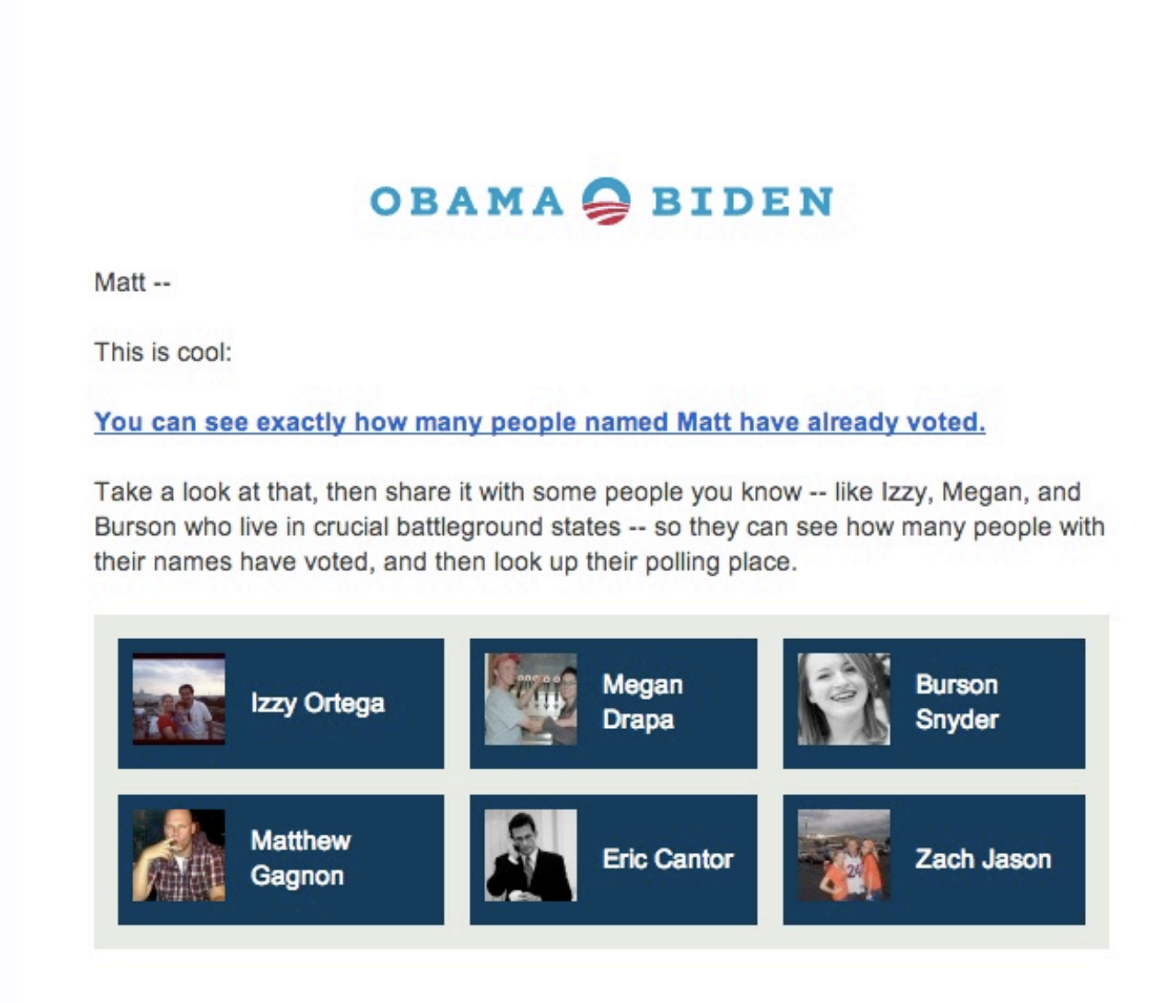
Data (Record) Linkage

Slide 8
Linkage: Goals
Determine if pairs of records describe the same entity
Main applications:
Joining two different data sources
Removing duplicates from a single data source

Slide 9
Record Linkage: Synonyms
(data) matching
merge/purge
duplicate detection
de-duping
reference matching
co-reference/anaphora resolution

Slide 10
Factors to consider
Deduping or Linkage
1-1 or 1-many or many-1
Rule-based or ML based
Do you have labeled training data?
Domain specific or generic similarity metrics?
Evaluation metric
Precision or recall
Task-specific - Implications on future analysis (bias for example)

Slide 11
Approaches
Exact matching
Rule-based
Probabilistic linkage

Slide 12
Common reasons for mismatches
Case (capital, lower case, etc.)
Nicknames
Prefixes
Suffixes
Initials
Punctuation
Spaces
Digits
Transpositions
Abbreviations

Slide 13
When are two records about the same entity?
Examples of possible similarity metrics
Edit distance
Soundex

Slide 14
“Fuzzy” Matching System
Apply set of cascading rules
Assign confidence score based on which rules fire

Slide 15
How do we not compare every pair?
How do we avoid looking at |A| * |B| pairs?
Blocking: choose a smaller set of pairs that will contain all or most matches.
Simple blocking: compare all pairs that “hash” to the same value (e.g., same Soundex code for last name, same birth year)
Extensions (to increase recall of set of pairs):
Block on multiple attributes (soundex, zip code) and take union of all pairs found.
Windowing: Pick (numerically or lexically) ordered attributes and sort (e.g., sort on last name). The pick all pairs that appear “near” each other in the sorted order.

Slide 16
Machine Learning based Record Linkage
Generate training data
Label pairs as match/no match
Generate features over each pair
Distance metrics over different attributes (fname, lname, dob, etc.)
Tfidf scores
Build and evaluate classifiers

Slide 17
One-off versus recurring matching
Unique identifiers: persistence?
What do we do with new or changed pairs?

Slide 18
Things to remember
Make sure and check that you can access your project data today
What’s coming next week:
Assignment
Weekly review
ACS Data loading
Readings
Make sure to read project proposal preparation guidelines

